Slide 1

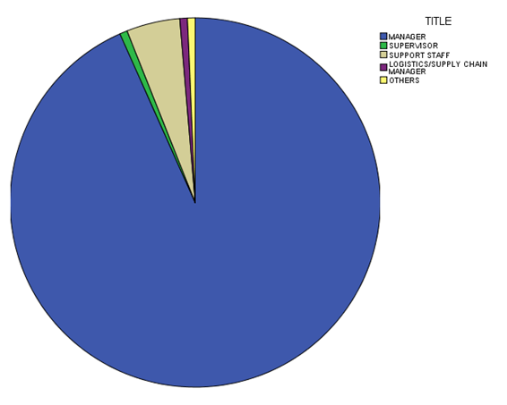
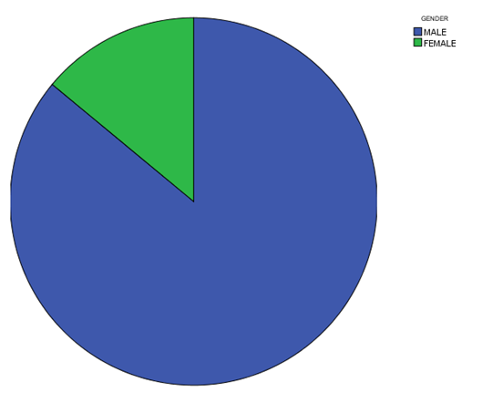
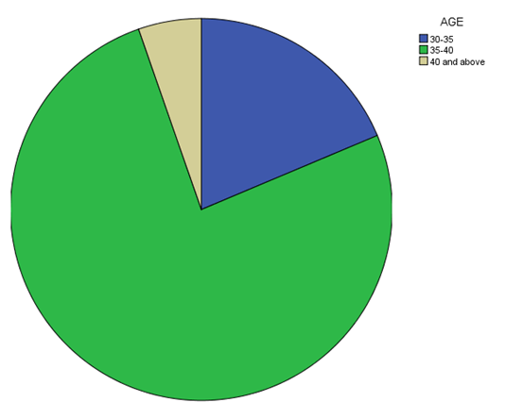
Eric S.W. Chana,, Alice H.Y. Hona, Wilco Chana, Fevzi Okumus. 2014 What drives employees' intentions to implement green practices ?The role of knowledge, awareness, concern and ecological behavior. The International Journal of Hospitality Management 40 (2014) 20-28. Kaplan, S., 1991. Beyond rationality: clarity-based decision making. In: Garling, T., Evans, G. (Eds.), Environment, Cognition and Action. Oxford University Press, New York, pp. 171–190. Kaiser, F.G., Wölfing, S., Fuhrer, U., 1999. Environmental attitude and ecological behaviour. J. Environ. Psychol. 19, 1–19. Kaiser, F.G., Oerke, B., Bogner, F.X., 2007. Behavior-based environmental attitude: development of an instrument for adolescents. J. Environ. Psychol. 27 (3), 242–251.
TITLE : THE ANALYSIS ON THE AWARENESS OF GREEN LOGISTICS PRACTICES AND INDUSTRIALIST’S INTENTION IN ADOPTING THEM
Eastern Trade Logistics, Port Konsortium, PKT, Agility Logistics Sdn Bhd, Gudang FELCRA, Trancy logistics (M), Sdn Bhd, Jade Logistics Service Sdn. Bhd., Gebeng
ABSTRACT
In this study, the focus is on the logistical industry as they are the party that deal with transportation execute greener practices in their companies. The study will examines their awareness of the green practices and also identify the barriers in adopting the green practices in the industry. The logistical companies are located in Gebeng Kuantan, Pahang. The findings from the study will hopefully be able to provide further exposure for researchers, and to ensure collaboration and partnership between environmentalists and the logistical industry. The findings were suited with the research objective, which was to assess the awareness of employees’ understanding of green logistics practices. The results are later on computed in SPSS.16 and the mean, t-test are done in order to find the results. The research conducted few questions regarding difference of awareness between men and women. There were several recommendations, such as conducting a huger sample and providing more results in obtaining more inclusive results that can be generalized on a larger population it is important to obtain a larger sample and to reach a more companies and a diverse population.
INTRODUCTION
FRAMEWORK
With the increasing awareness of global climate change and natural disasters, environmental protection is an issue of high topicality and relevance. Green logistics are practices that the logistics industry implements in order to reduce the contribution of air pollution and climate change to the environment. The awareness of green practices is important to all parties involved such as the government agencies and all the industrialists.
-EMPLOYEES UNDERSTANDING OF GREEN LOGISTICS
-COMPANY’S PRACTICES
-EMPLOYEES AWARENESS OF GREEN LOGISTICS
INTENTION TO IMPLEMENT GREEN PRACTICES
ECOLOGICAL BEHAVIOUR
INDEPENDENT VARIABLE
MEDIATING FACTOR
DEPENDENT VARIABLE
OBJECTIVE/S
RESULTS
i. To assess the awareness and understanding that employees’ at Industries in Gebeng have of Green logistics practices.
ii. To assess the barriers of green practices and also the contributing factors that influence decisions of industrialists in implementing these strategies.
IMPORTANT PRACTICE
BARRIERS
MEAN
MEASURE HAS NOT YET BEEN JUSTIFIED 4.2333
UNABLE TO SUSTAIN 4.8733
HIGH INVESTMENT COST 5.0000
UNCERTAIN PAYBACK PERIOD 5.0000
LACK OF FINANCIAL 4.8667
LACK OF HR 5.000
LACK OF KNOWLEDGE 4.6067
LACK OF IT 4.7400
LACK CUSTOMER 4.5200
LACK OF ECONOMIC 4.8667
LACK OF CLEAR REGULATION 4.4133
LACK OF ENVIRONMENTAL PLAN 4.7333
METHODS
Data collection took place between October 2nd until 22nd,2015. Several logistics company were to complete the
questionnaire.
The employees of the logistical companies will be given a questionnaire to be answered on their awareness of green logistical practices. The first part of the questionnaire is used to measure awareness is defined as knowing of the impact of human behavior on the environment. The concept was examined with a series of questions inquiring about the global environment.
The second part (part C) questionnaire is used to measure understanding that is defined as the state of one’s knowledge about an issue concerning the environment. The questionnaire will also examine the barriers face by them in implementing the green practices, factors behind the implementation of green.
The results are later on computed in SPSS.16 and the mean, t-test are done in order to find the results.
UNDESTANDING
FUTURE PLANS
UNDERSTANDING
 | N | Minimum | Maximum | Mean | Std. Deviation
FUTURE1 (future alternative fuels) | 150 | 1.00 | 5.00 | 1.3667 | 1.13762
FUTURE2(modification vehicles) | 150 | 5.00 | 5.00 | 5.0000 | .00000
FUTURE3(eco-driving) | 150 | 1.00 | 5.00 | 4.6867 | .91326
FUTURE4(recurrent environmental) | 150 | 1.00 | 5.00 | 4.6600 | .93285
FUTURE5 (Switch to less energy intensive transport modes ) | 150 | 1.00 | 5.00 | 4.8333 | .78933
FUTURE6(Greater use of intermodal transport) | 150 | 1.00 | 5.00 | 4.5133 | .95353
FUTURE7(Measures to improve vehicle loading) | 150 | 3.00 | 5.00 | 4.7333 | .68215
Most responsible party
86.4% of respondents are managers
0.6% of supervisors, 4.3% support staff
0.6% logistics/supervisors, 0.6% others.
79.6% respondents are male,
13% are female
17..4 % are above 40
40.3% of respondents are between 36-40
70.4 % of are between the age of 30-35
CONCLUSIONS AND RECOMMENDATION
Based on the research questions, the questionnaire were all answered successfully and the research objective which is to analyze the awareness of employees’ understanding of green logistics is being met. While most employees’ answered correct to environmental sustainability questions, the vast majority would give more comments to the implementation of green logistics. Most of the employees’ responded that they were not taking big incentives on green measures. There also seem to be lack of environmental office in most of the logistics companies visited. Undeniably, there is interest in the implementation of green practices.

