Slide 1

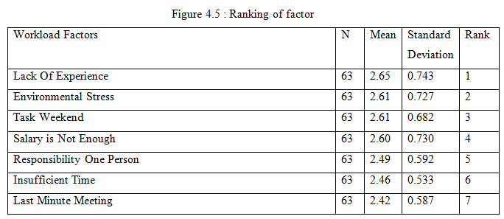
A STUDY THE EFFECT OF WORKLOAD ON THE WORK PERFORMANCE IN THE CONSTRUCTION INDUSTRY
MUHAMMAD AZUAZEY BIN ABDUL MALIK
PB11089
ABSTRACT
The workload is an important and even become a major concern for all organizations in the construction industry. This is because the workload is very closely related to determining the performance of an employee. High performance work systems are the factors that distinguish leading organizations. This study is intended to examine one of the effects of workload on the work performance of the construction industry in Kota Bharu only. This study only focused on contractor-grade G7 in Kota Bharu, as contractor grade G7 have more projects that need to be and hereby controls the more their workload to be fought. There are two objectives in this study. The first objective is to identify factors that contribute to employee's workload and the second is to determine the rank of the factors that contribute to employee's workload in the construction industry.This study are using quantitative research design as an important tool consists of two parts , Part A and Part B. Part A describes the demographic information from the respondents and the project company. Part B is according to research objectives. Data were analyzed using SPSS. The data will be analyzed to determine the position of each of the factors that influence the effect of workload on the performance of the construction industry. A total of 112 questionnaires were distributed to respondents in the construction industry in Kota Bharu to determine which of the main causes of their workload is causing performance degradation. In determining the rank of the factors that contribute to the workload, this study will identify which of the factors that are significant and insignificant that resulted in the workload for employees.
INTRODUCTION
RESULTS
Workload which refers to mental stress faced by the employee because work assignment that is noticeable. Other than work assignment that is noticeable, many other variables which can contribute to the occurrence of pressure and burden to base on previous studies, pressure factors work can be classified into a few groups. Among them is problem on work shift, assignment weekend, salary that's not enough, working hours that are prolonged, discrimination and also a security issue. With the occurrence of problem for workers, this will cause occurrence of problem to assignments given.
Change workload should be carried out to change, stress levels working pressure that can affect work performance. Working pressure not bringing meaning that is bad or negative, because it is a chance for the employee is successful and learns quickly. The employees that go through this workload usually they will become more active compared to on the other hand. In addition, employees will get working experience that more and can add their exposure in the assignment. This is called as pressure workload that is positive which could bring about productivity. For employee which had no skill, advantage and capacity to handle work which many and problem faced, it will cause working pressure happened. When working pressure will become excess, it will cause negative impact to staff. Generally, working pressure is one of the source discomforts in personal level employee, unless a person the employee able to handle or handling the problem work load positively. (Melta, 2004)
OBJECTIVE/S
To identify the factors that contribute to employee’s workload.
To rank the factors that contribute to employee’s workload
METHODS
By Hand Questionnaire
    This questionnaire were given by hand to employee construction company .
Email Questionnaire
  This method using internet to give email for construction company.
SPSS Software
  This software use to analyze all data collection that getting from survey.
CONCLUSIONS AND RECOMMENDATION
The conclusion that can be drawn from the first objective and objectives two, namely to identify the factors that contribute to employee's workload and to ranks of the factors that contribute to employee's workload is the factor which can make significant and insignificant to those experienced by employee. SPSS was used in the analysis to find out the real cause of the workload found that lack of experience in the field is doing a heavy impact on the workload. The results obtained by respondents who answered the questionnaire provided. And the results of this study also found that last minute meeting is the lightest to the employee. Each of these factors can have an impacts on every employee.
Recommendation
1. The organization is to help workers who are in trouble
2. Problem reduction method

