Slide 1


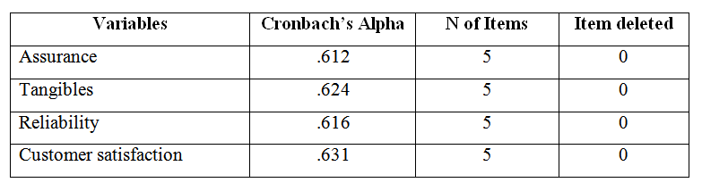
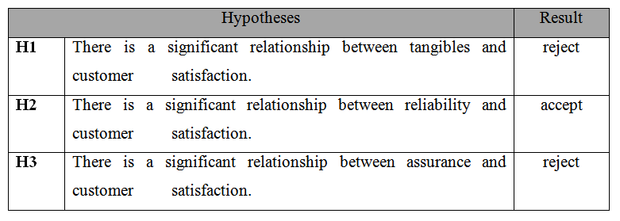
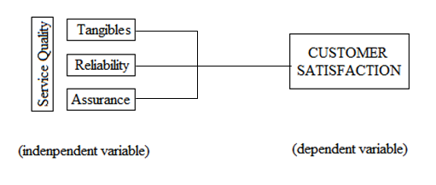
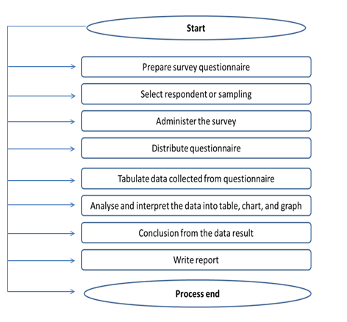
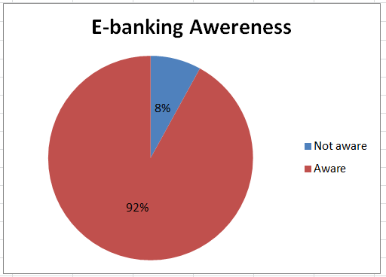
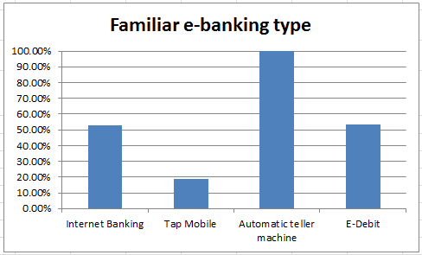
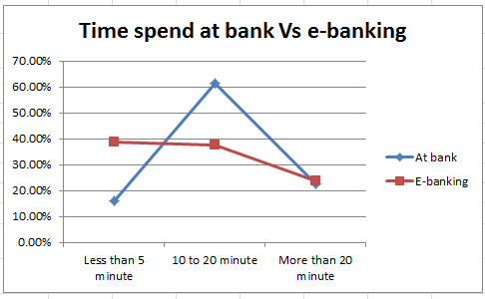
THE IMPACT OF ELECTRONIC BANKING ON SERVICE DELIVERY TO CUSTOMERS OF BANK
ISLAM MALAYSIA BERHAD IN KUANTAN
MOHD MUHAIMIN BIN MOHD PIAH PC10045
BACHELOR OF INDUSTRIAL TECHNOLOGY MANAGEMENT
UNIVERSITI MALAYSIA PAHANG
ABSTRACT
This research was intended to solve the problems of a study on service quality in relations towards customer satisfaction among Bank Islam customer toward e-banking. Considering that they still don’t have viable research this research was been take place to focus on several dimensions of service quality and customer satisfaction means to measure and evaluate the service quality of the relationship and indentify most significant service quality component for e- banking services. So the main goal of this research is to help them find the how significant service quality toward customer satisfaction so banker can use this factor for current and future improvement. This research also can be used to rank the most and lowest related service quality component to customer relation. Therefore to find most significant component, most of statistical software tools (SPSS) analysis such Cronbach's Alpha, Pearson correlation, Multiple Regression Analysis, and Anova was been used to analyst data that were collected by questionnaire.
INTRODUCTION
RESULTS
BACKGROUND OF STUDY
A study on service quality in relations towards customer satisfaction among e- banking services customer in Kuantan was being conducted and seeks the extent to which e-banking has influence service quality in service delivery of Bank Islam Malaysia Berhad in Malaysia.
PROBLEM STATEMENT
To take closer look on e-banking services and to find the best component related customer satisfaction on banking services
Summary of reliability analysis by group.
RESEARCH OBJECTIVE/S
Identify the relationship between service quality (assurance, tangibles, and reliability) with customer satisfaction on e-banking services provided by Bank Islam in Kuantan.
Identify the most significant service quality (assurance, tangibles, and reliability) toward customer satisfaction on e-banking services provided by Bank Islam in Kuantan.
THEORETICAL FRAMEWORK
Summarizes from the overall hypotheses testing result. It can be concluded that the hypotheses H2 are accepted. Therefore, hypotheses H1 and H3 are rejected.
METHODS DATA COLLECTION AND DATA ANALYSIS
Picture/Chart
Picture/Chart
Percentages of e-banking awareness
Familiar type of e-banking by the Bank Islam customer
Time used benchmark for physically vs. e-banking
CONCLUSIONS AND RECOMMENDATION
This research concluded reliability have sufficient evident of positive relation with customer satisfaction than assurance and tangibles on e-banking services provided by Bank Islam in Kuantan. The reliability was highlighted to be most significant service quality component toward customer satisfaction on e-banking services.
Recommendation: Service quality must be improved in order to create a comfortable environment, and use to select appropriate action for improvement in the current and future plan.

