Slide 1

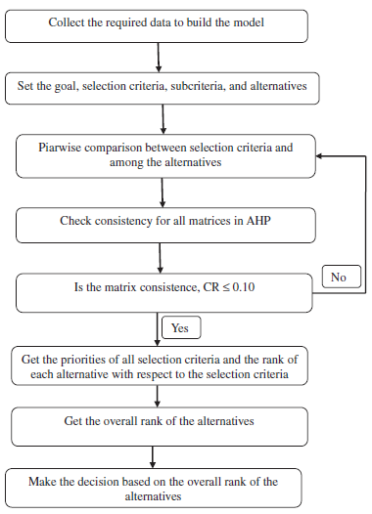
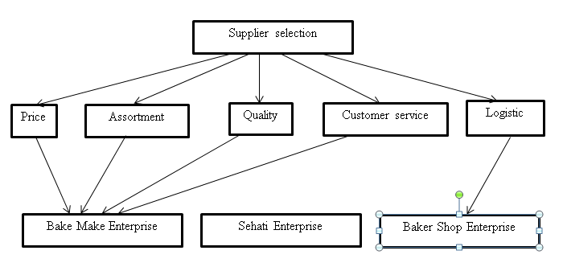
ANALYZING SUPPLIER SELECTION BY USING AN ANALYTICAL HIERARCHY PROCESS (AHP) AT AJ CONFECTIONARY SDN. BHD.
Che Syahada Bt Che Azeman,
Bachelor Degree Industrial Technology Management,
Universiti Malaysia Pahang.
ABSTRACT
This study was aimed to analyze the supplier selection by using an Analytical Hierarchy Process (AHP) at AJ Confectionary Sdn. Bhd. The objectives of this study are to identify the selection criteria for supplier selection at AJ Confectionary Sdn. Bhd., to Analyze the supplier selection of Aj Confectionary Sdn. Bhd. and to make a framework for the supplier selection at AJ Confectionary Sdn. Bhd. This study was come out based on the problem statement which is AJ Confectionary Sdn. Bhd. have more than one supplier which will contribute to the high variance in quality and cost. It also comes from the problem that most of the company in food industry does not consider the quality as a criteria in providing a product to their customers. The scope of this study is at cake and bakery shop, AJ Confectionary Sdn. Bhd., Kuantan. The data was obtained by doing a structured interview. This study had interviewed the Manager of AJ Confectionary Sdn. Bhd. based on the nine-scale of the Analytical Hierarchy Process (AHP) model. As a result of this study was identified that there are proven that the most important criteria that considered by the AJ Confectionary Sdn. Bhd. in selecting the supplier is the price . In the other hand, there are also proven that, they does not consider the quality as a main criteria in selecting the supplier. It is proven also that, the Analytical Hierarchy Process (AHP) is a method that can make a decision making more simple as the decision maker can make a framework based on the hierarchy.
INTRODUCTION
RESULTS
This study use a quantitative analysis as an approach to the supplier selection problem. Analytical Hierarchy Process (AHP) had developed by Saaty (1970s) which is highlighted the way to determine the weight percentage of a activities in a multi-criteria problems. In supplier selection decision making for the food industry, there a number of criteria and sub-criteria. So, this criteria need a pairwise comparison in order to analyze it.
Criteria | Consistency Ratio
Price | 0.0312
Assortment | 0.0032
Quality | 0.3307
Customer Services | 0.5336
Logistics | -0.0116
Consistency Ratio ≤ 0.10 is consistent!
RO 1
OBJECTIVE/S
Table 1: Consistency Ratio For Selection Criteria
To identify the selection criteria for supplier selection at AJ Confectionary Sdn. bhd.
To analyze the supplier selection of AJ Confectionary Sdn. Bhd. using an Analytical Hierarchy Process (AHP).
To make a framework for the supplier selection at AJ Confectionary Sdn. Bhd.
RO 2
Criteria | Criteria Weight
Price | 0.284
Assortment | 0.326
Quality | 0.044
Customer Services | 0.186
Logistics | 0.160
Consistency ratio | 1.0736
Supplier | Total weight evaluation | Rank
Bake Make Enterprise | 0.5392 | 1
Sehati Enterprise | 0.0964 | 3
Baker Shop Enterprise | 0.3535 | 2
METHODS
Figure 1.0: AHP Model from Mayyas et. al. (2011)
Documented Data
Structured Interview
Table 2: Priorities for selection criteria
Table 3: Final ranking of supplier
RO 3
Table 4: Framework for supplier selection at AJ Confectionary Sdn. Bhd.
CONCLUSIONS AND RECOMMENDATION
Conclusion
The most preferable criteria of AJ Confectionary Sdn. Bhd. is the price and the quality is the last preferable criteria that had been consider y AJ Confectionary Sdn. Bhd. From this study, it can be conclude that An Analytical Hierarchy Process is a preferable method in selecting the supplier.
Related Journal
Regarding to Prusak et. al (2013) the AHP method is different from the other method since it is more simple, flexible and has dedicated software (i.e. Super Decisions) allowing quick calculation of priorities.
Recommendation
Future study should combine the AHP method with the Quality Function Deployment as an external factor in a study.
Future study also should try more than one industry in order to analyze and compare the supplier selection activities in each industry.

