Slide 1

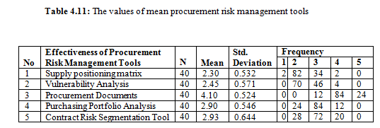
THE EFFECTIVENESS OF PROCUREMENT RISK MANAGEMENT TOOLS IN CONSTRUCTION PROJECT
Faculty of Industrial Management
SONG HARN YEAN PB11030
ABSTRACT
This research aims to minimise the opportunity for procurement risks to occur and their impacts should they occur during construction procurement process. A survey using a structured questionnaire was conducted. A total of 40 construction company which register in CIDB Malaysia where located in Kedah are taken for this research. Referring to the effectiveness procurement tools and techniques, discriminant analysis was carried out and the results have showed the effectiveness of all these procurement risk management tools. Effectiveness shown was carried out with the statistical package for social sciences. Some of the procurement tools must be adopted in the construction industry to manage procurement risks and reduce uncertainties.
INTRODUCTION
In the construction industry, project risks in procurement process are regarded to the contract administration, negotiating the contract, selecting the appropriate procurement methods, developing, etc.
Since risk cannot be eliminated, procurement risk should be identified and assessed on a case by case basis, as it is better to be proactive than reactive.
Hence, procurement risk management tools should be applied in the construction industry in order to manage procurement risk and reduce uncertainties.
OBJECTIVE
RESULTS
To determine the effective procurement tools and techniques in managing construction project risk.
The highest mean value is dedicated to the most effective procurement tool.
METHODS
Distribute questionnaire and collect the data from respondents
Preliminary analysis
Analysis Data
email (Google Docs)
Reliability analysis (Cronbach‘s Alpha >0.7)
Questionnaire Design
five-point Likert scale
Microsoft Excel, SPSS (frequency mean, Standard deviation)
CONCLUSIONS AND RECOMMENDATION
Procurement documents has ranked the most effective procurement tool according to the mean value of every procurement tool.
Contract risk segmentation tool and purchasing portfolio analysis have obtained almost similar mean value which are 2.93 and 2.90 -have moderate effectiveness in managing construction procurement risks.
Identifying appropriate procurement strategies for a particular procurement.
The putting in place of a documented risk register which includes a description of the risk and a description of the actions which are to be taken to avoid or reduce the risk.

