Slide 1

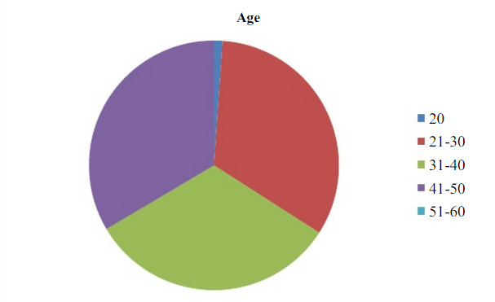
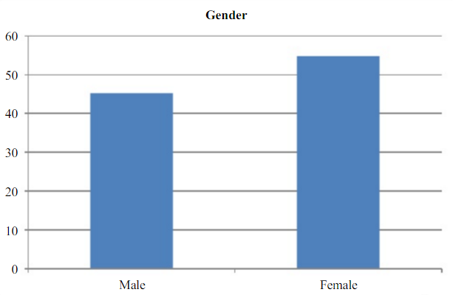
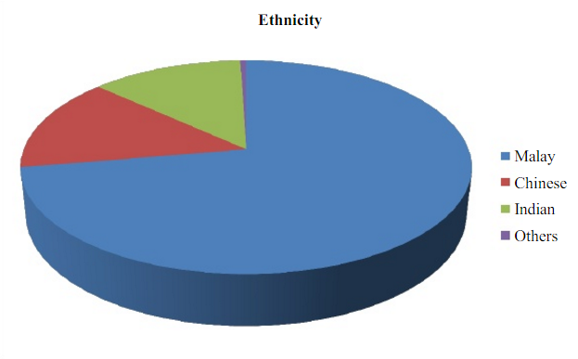
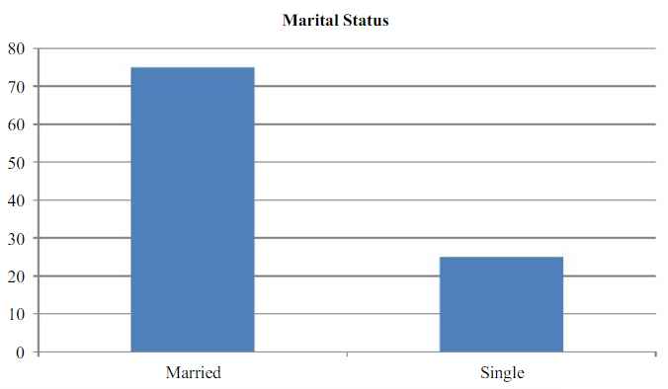
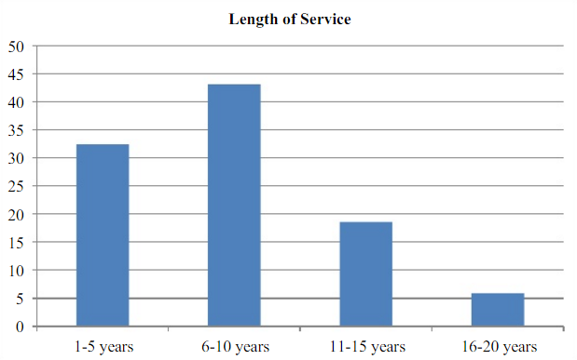
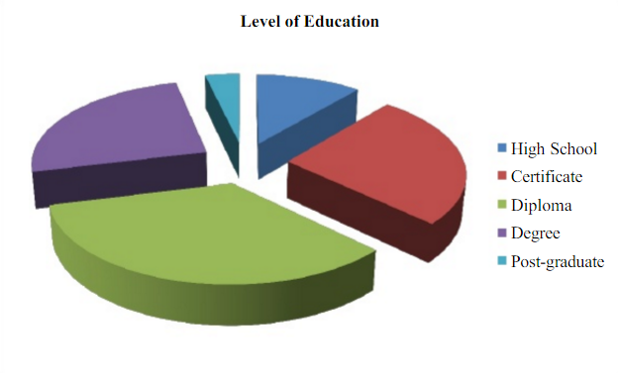
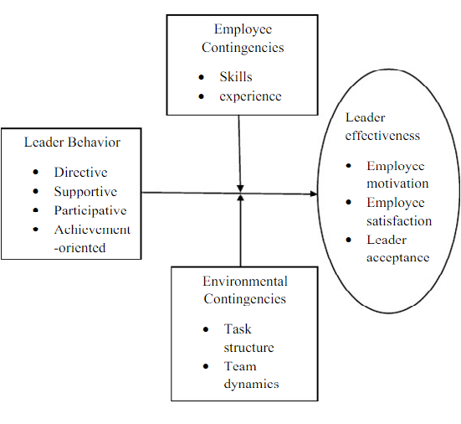
THE IMPACT OF ETHICAL LEADERSHIP BEHAVIOUR ON ORGANIZATIONAL COMMITMENT AND EMPLOYEES’ TRUST. A Study At Vacuumschmelze (M) Sdn. Bhd., Pahang
MUHAMAD LOTFI BIN JALIL (UNIVERSITI MALAYSIA PAHANG)
Supervisor DR. CHENG JACK KIE
ABSTRACT
Company performance always can be improve and can be enhance. The research is focused in impact of ethical leadership behavior can improve the performance of the organization among officials Vacuumschmelze (M) Sdn. Bhd., Pahang.
INTRODUCTION
RESULTS
each organization has a diverse personalities who lead different from each other. These personality differences can influence the attitudes, values and behavior of other employees in the workplace that will affect the performance of the organization.
OBJECTIVE/S
a) To determine the relationship between employee perception of their leader’s ethical behavior to organizational commitment.
b) To determine the relationship between employee perceptions of their leader’s ethical behavior and employee trust in the leader.
Descriptive Analysis | Organizational Commitment (OC) | Trust in leader (TIL)
Mean | 3.83 | 3.72
Std. Deviation | 0.58 | 0.58
Variance | 0.34 | 0.33
Minimum | 2.33 | 2.29
Maximum | 5.00 | 4.86
Descriptive Analysis | Ethical Leadership Behavior (ELB)
Mean | 3.97
Std. Deviation | 0.59
Variance | 0.35
Minimum | 2.40
Maximum | 4.90
METHODS
Questionnaire
Distributed to the target audience
SPSS software (software package used for statistical analysis)
perform data entry and analysis and to create tables and graphs.
Objective 1 of this study was to examine the relationship between employee perception of their leader’s ethical behavior and organizational commitment. The positive correlation (r = +0.704) shows the relationship that exists between the variables is a high positive correlation.
objective 2 was to examine the relationship between employee perception of their leader’s ethical behavior and employee trust in the leader. The positive correlation coefficient (r = +0.591) shows the relationship that exists between the variables is a high positive correlation.
 | Research hypothesis | Findings
H1 | There is a positive relationship between organizational commitment and ethical leadership behavior. | H1 accepted
H2 | There is a positive relationship between trust in leader and ethical leadership behavior. | H2 accepted
CONCLUSIONS AND RECOMMENDATION
The outcomes of hypothesis testing confirmed that independent variable have a relationship with dependent variable. It is recommended that these studies be applied to others organizations in Malaysia. This study was conducted using questionnaire and only took a short time. It is recommended that in future researchers conducting this kind of study use others instrument such as an interview technique which is of course time consuming. Ethical leadership behavior can influence the organizational performance.

