Slide 1

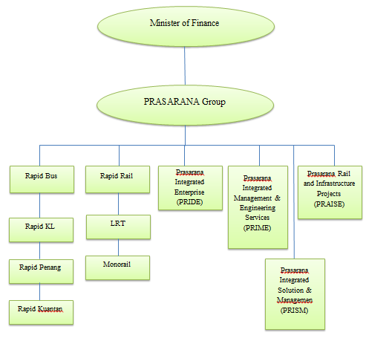
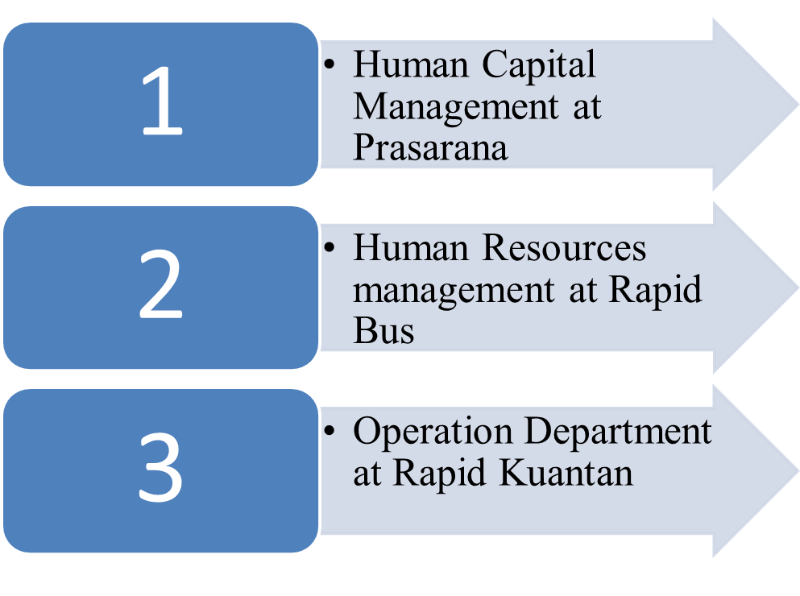
A STUDY ON THE GOVERNANCE OF TALENT MANAGEMENT PROGRAM AT
RAPID KUANTAN
MUHAMMAD NUR HAFIZUDIN BIN SANUPIN
BACHELOR OF INDUSTRIAL TECHNOLOGY MANAGEMENT WITH HONS.
ABSTRACT
This research is a study on the governance of talent management at Rapid Kuantan Sdn Bhd. This study was conducted to examine the instuitional structure in relation to talent management and to analyze the impact from implementation of talent management program to the employees. This study area are in Rapid Kuantan Depoh at Semambu, Kuantan. To achieved the objective, the interview will be used as data collection. Data collection will be analyse whether the instuitional structure of talent management affect the employees and company performance. Based on interview, his program give positive impact for companies. For conclusion, this talent management program will help company to manage human capital more effectively and efficient .
INTRODUCTION
RESULTS
What are the relation between instuitional structure and talent management ?
How does the talent management program help for better improvement of employees performance ?
Employee welfare
BAKIP ( Badan kebajikan Islam Prasarana)
KSKKP (Kelab Sukan dan Kebajikan Kumpulan Prasarana)
Insurance Coverage
Medical coverage
2. Recruiting/Training
Rapid kuantan collaborate with Minister of Youth and Sport to do Bus Captain Bootcamp
The candidate must undergo 3 month training.
3. Reward
Attractive bonus
Continuous training and development program
4. Succession Planning
essential for identification and development for successor in a company.
Dato Sri Shahril now currently held Chief Executive Officer of MRT Corp on September 2011 ,and one of the Board of Director for Prasarana Malaysia Berhad and MyHSR (High Speed Rail) Corp.
Dato’ Sri Shahril was attached to RapidKL as its General Manager of Corporate Planning before being promoted.
OBJECTIVE/S
To examine the instuitional structure in relation to talent management.
To analyze the impact from implementation of talent management program to the employees at Rapid Kuantan.
METHODS
The data was collected by using interview method. The instrument used is interview.
Development of interview question
No
validation
Picture/Chart
yes
Conduct the interview
Analysis of data
Conclusion and recommendation
Instuitional Structure of Prasarana Malaysia Berhad
Standard Operating Procedure of Talent management at Rapid Kuantan
CONCLUSIONS AND RECOMMENDATION
CONCLUSION
Based on interview, talent management already applied at Rapid Kuantan. This program help companies to manage talent of human capital more effectively and smoothly. Thus for conclude, the objective for this research are achieved.
RECOMMENDATION
Rapid Kuantan already have talent management program for the worker. However, this talent management program must be continuously improved because worker satisfaction will be differs in the future.

