Slide 1

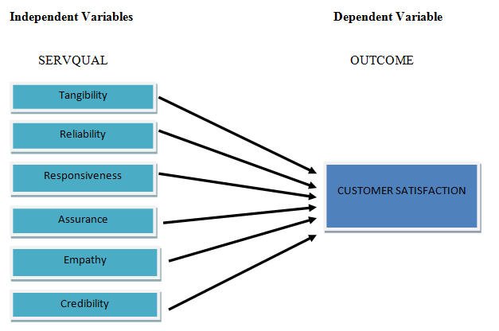
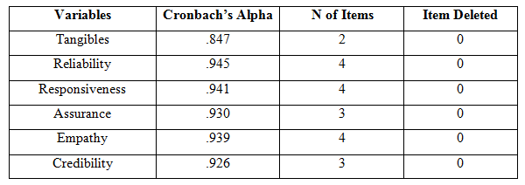
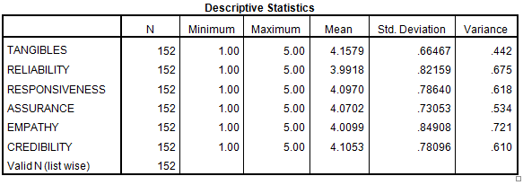
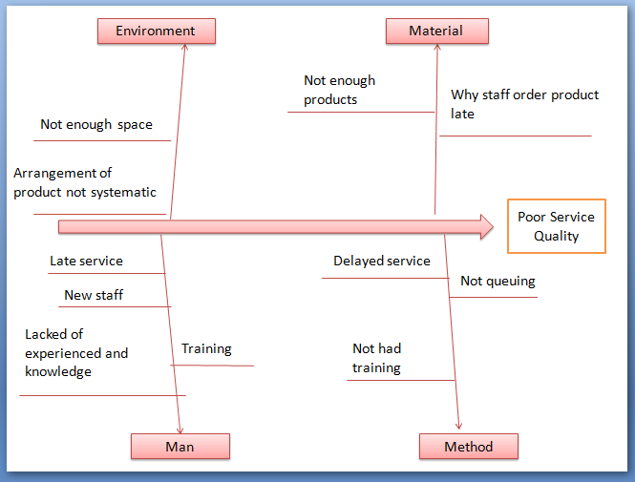
ENHANCING THE CUSTOMER SATISFACTION EXPERIENCE AT A PHARMACY IN
KUALA BERANG, TERENGGANU
NUR ALIAH SHAHIDAH BINTI MOHAMMAD ISA (PC 13070)
BACHELOR OF INDUSTRIAL TECHNOLOGY MANAGEMENT WITH HONS.
FACULTY OF INDUSTRIAL MANAGEMENT, UNIVERSITI MALAYSIA PAHANG (UMP)
ABSTRACT
The aim of this study, is to identify the current customer satisfaction experience at a pharmacy in Kuala Berang, Terengganu. In this study, the author has tried to identify the service quality based on SERVQUAL tools in order to enhance the customer satisfaction. To proceed with this study the author will utilize the quantitative method using the customer of a pharmacy in Kuala Berang to be a respondent . Based on the study on six dimensions in SERVQUAL tools, the researchers found that Reliability, Responsiveness and Empathy can be further improved to enhance the customer satisfaction experience. The data had been done to 152 respondents. Then, researcher was analyzing data using SPSS software. This system can help the researcher to compute and determine the information that was given from respondents that answer the questionnaire based on SERVQUAL dimensions..
INTRODUCTION
OBJECTIVES
METHODS
Poor service quality was one of the issue faced by the Farmasi Aiman in Kuala Berang, Terengganu. Therefore, in this study the researcher will try to used SERVQUAL tools as a main to identify the level of customer satisfaction experiences by the patron of the pharmacy. To help the researchers to analyze the data SPSS softwarre has been used to identify the customer satisfaction. Using the Fishbone Diagramas the main brainstorm the possible cause and combine with 5 Why technique. The researchers found that lacked of knowledge and experience of the staff because do not had enough training so the purpose solution was the pharmacy need to hire more trainer.
RO1:To identify the level of customer satisfaction experience by the patron of the pharmacy
RO2:To propose the improvement that can be enhance customer satisfaction
Formulate research problem and objective
Collection data of respondents (152 respondents)
Analyze data using Statistical Package for the Social Science (SPSS) Software
RESULTS
Figure shows the conceptual Framework on the Relationship between SERVQUAL called Independent Variables and Customer Satisfaction called Dependent Variables.
Figure shows summary of reliability analysis
Figure shows analysis of descriptive statistics
Why poor service quality? | Why do not have standard procedure to treat the customer? | Why lack of knowledge? | Why do not have training? | Why pharmacy not had enough training?
Why poor service quality? | Why not reached customer expectation and perception? | Why too many customers? | Why not enough staff? | Why save cost?
Why poor service quality? | Why not enough products? | Why staff order product late? | Why too many product need to be handle? | Why there is no system that can detect when a product run out?
Why poor service quality? | Why not enough space? | Why arrangement of product not systematic? | Why do not have warehouse? | Why to rent the warehouse expensive?
Method
Man
Material
Equipment
Figure shows analysis of Fishbone Diagram
Figure shows analysis 5 Why Analysis
CONCLUSIONS AND RECOMMENDATION
CONCLUSION | RECOMMENDATION
Pharmacy problematic because the pharmacy has poor service quality Reliability, Responsiveness and Empathy was the practice of the most difficult and problematic to improvement | Program about the service quality dimensions P-D-C-A for Service quality

