Slide 1



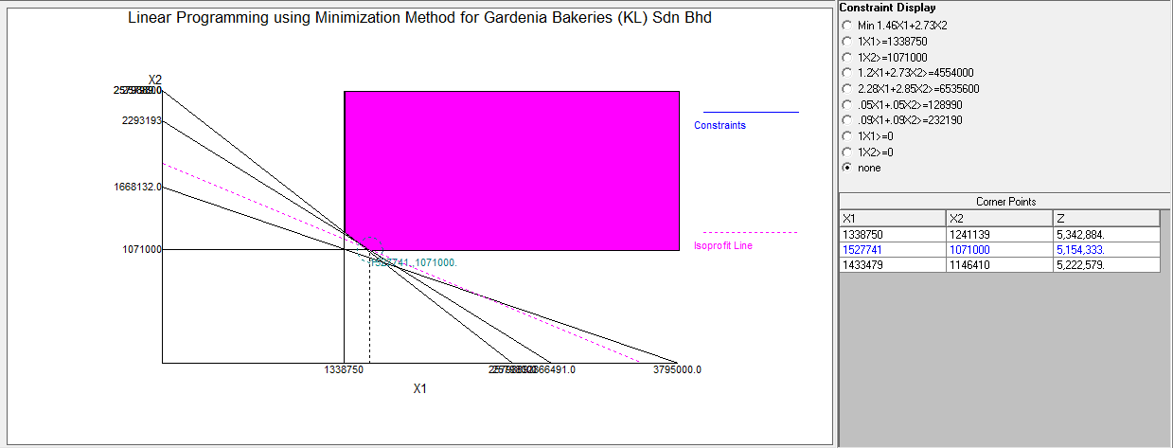

LINEAR PROGRAMMING METHOD FOR MINIMIZING PRODUCTION COST IN BAKERIES INDUSTRY IN MALAYSIA
Authors : ABDUL RAHMAN BIN BEDEROHISAM ID NUMBER: PC13058
DR. SHRIKANT PANIGRAHI
BACHELOR OF INDUSTRIAL TECHNOLOGY MANAGEMENT WITH HONOR
UNIVERSITI Malaysia PAHANG
ABSTRACT
This research is about the linear programming method for minimizing production cost in bakery industry in Malaysia. Nowadays, many industry in every sector wants to minimizing production cost in their business. The linear programming method is the best solution to achieve the company objective to maximize profit or minimize cost depending on company target goal. The basic problems in production cost in the industry are increase in raw materials cost, labour cost, storage cost and others. Using the linear programming can give the best optimal solution point that give the best level of productivity amount by several variables. In this paper presents results implementing the linear programming method by using a computer software that give the result and graph of optimal solution point. The objective function and also the constraints are shown in this research. The linear programming models was developed using Production/Operation Management and Quality Management (POM/QM) Software in analysis. The study was taken from a bakery industry in Malaysia that produce bread. From the analysis it was concluded that we can reduce 10.19% of total production cost when optimize the production level . Others suggest ion that substitute some of the raw material that is eggs to substitute item that is soy protein isolate and wheat gluten and also use lean management.
INTRODUCTION
RESULTS
Today, in the modern era industrialization become growth rapidly and various type industries in the worldwide. The industries is very important to increase the economic growth of the country. Also in the one industry for example bakery industry have many industry players and company that involve in this industry. To survive in this industry it need for the company do the planning and strategies to make sure that they can compete with others in the market. Especially in the bakery industry, the company is target in increasing the profit for the company so the focus strategy of the company is to reduce the total cost of production.
Besides, in the bakery industry there are some production problem occur in the industry. It need to the manager to plan the effective way to solve the problem occur in this industry like production line problems, waste during production, storing, raw materials and others.
FINAL MODEL
Minimize : Z = RM 1.46X1 + RM 2.73X2
X1 ≥ 1,338,750 ... units demand of Product A
X2 ≥ 1,071,000 …units demand of Product B
1.2X1 + 2.47X2 ≥ RM 4,552,000 …raw materials cost
2.28X1 + 2.85X2 ≥ 6,535,600 …labour time (minutes) required
0.05X1 + 0.05X2 ≥ RM 128,990 …fuel/power cost
0.09X1 + 0.09X2 ≥ RM 232,190…others cost
X1,X2 ≥ 0.
Where
X1 = the number of Product A
X2 = the number of Product B
Z = the total cost of both product (Product A and Product B) in quarter year.
MODEL ANALYSIS IN PRODUCTION/OPERATION MANAGEMENT AND QUALITY MANAGEMENT (POM/QM) SOFTWARE
Figure 4.2 Graph of Linear Programming Minimizing Method for Gardenia Bakeries (KL) Sdn Bhd.
…Hence the Optimal Solution Point is X1 = 1,527,741 units and X2 = 1,071,000 and the production cost is Z =RM 5,154,333
The Cost Saving Percentage %
= $\frac{Actual Production Cost−Linear Programming Production Cost }{Actual Production Cost} X 100\%$
=$\frac{RM 5,739,300−RM 5,154,333}{RM 5,739,300} X 100\%$
= 10.19%
PROBLEM STATEMENT
In the bakery industry of Malaysia, it is out of control of the labour cost and bakers have to pay at the prevailing rates to the labour. (Leslee Spiess & Peter Waring, 2005).
The long-time storing the product either finished products or the semi-finished products, the retention and preservation cost will increase. (Tung-Lai Hua et al, 2016).
OBJECTIVES
1. To minimize production cost in bakery industry.
2. To meet the demand of product in the market of bakery industry.
METHODS
Quantitative Research Method
Production/Operation Management and Quality Management (POM/QM) software
CONCLUSIONS AND RECOMMENDATION
After we doing linear programming method, we can get the optimal solution point that is prove that it will reduce 10.19% of total production cost of the company.
We can substitute some of the raw material that is eggs to substitute item that is soy protein isolate and wheat gluten. The soy protein isolate and wheat gluten can be used to substitute the eggs in bakery product.
The lean management is the system that is integrated technically that the major objective to eliminate waste by decreasing and reduce supplier, internal variability and customer.

